Slide 1
General Form of Divide-and-Conquer Recurrence
Prof. Joarder Ph.D.
Institute of Information Technology (IIT)
University of Dhaka

Slide 2
#include <stdio.h>
int main() {
int n = 16; // Example value of n
int a = 2; // Example value of a
int b = 2; // Example value of b
int result = T(n, a, b);
printf("T(%d) = %d\n", n, result);
return 0;
}
// Function to represent T(n) = a * T(n/b) + n
int T(int n, int a, int b) {
// Base case: when n becomes small (like 1 or 0)
if (n <= 1) {
return 1;
}
// Recursive case: follow the formula T(n) = a * T(n/b) + n
return a * T(n / b, a, b) + n;
}

Slide 3
✅ Explanation
T(int n, int a, int b) is a recursive function that calculates T(n).
Base case: If n becomes small (<=1), we stop recursion and return 1.
Recursive case:
It calls itself with n/b, multiplies the result by a, and adds n — exactly like your formula.
Example:
Suppose:
n = 16
a = 2
b = 2
int T(int n, int a, int b) {
// Base case: when n becomes small (like 1 or 0)
if (n <= 1) {
return 1;
}
// Recursive case: follow the formula T(n) = a * T(n/b) + n
return a * T(n / b, a, b) + n;
}
T(16)= 2 * T(8) + 16
T(8) = 2 * T(4) + 8
T(4) = 2 * T(2) + 4
T(2) = 2 * T(1) + 2
T(1) = 1 (base case)

Slide 4
🔁 Step-by-Step Tracing Method for aT(n/b​)+f(n)
Using a tracing tree (aka recursion tree) is a visual method to deduce the recurrence relation:
T(n)=aT(n/b​)+f(n)
Let me walk you through it step-by-step, with diagrams and a real example.
🎯 Goal:
To understand how work accumulates in the recursion tree and how it leads to the recurrence.

Slide 5
✅ Step-by-Step Breakdown (with Example)
Let’s use: T(n)=2T(n/2​)+f(n)
Step 1: Draw the Root (Level 0)
Root is the original problem of size n
The work done at this level is f(n)=n
Level 0: T(n)
|
------------------
| |
Level 1: T(n/2) T(n/2)

Slide 6
Step 2: Expand Each Node (Recursive Calls)
Each node makes 2 recursive calls to half the size:
Level 0: T(n)
[n]
|
--------------------------------
| |
Level 1: T(n/2) T(n/2)
[n/2] [n/2]
/ \ / \
Level 2: T(n/4) T(n/4) T(n/4) T(n/4)
[n/4] [n/4] [n/4] [n/4]
Each level has 2^{𝑖} nodes
Each node does work = 𝑛/2^{𝑖}
Total work per level = 2^{𝑖}⋅(𝑛/2^{𝑖})=𝑛

Slide 7
Step 3: Determine Number of Levels (Tree Height)
The recursion stops when:
n/2^{k}=1 ⇒ k=log₂n
So, the tree has log₂n + 1 levels.
Step 4: Total Work (Sum Over Levels)
Each level costs n units of work.
So total cost:
n x (log₂n + 1) = n log₂n + n ⇒ T(n)= Ɵ(n log₂n)

Slide 8
🧠 Generalization
For:
T(n)=aT(n/b​)+f(n)

Slide 9
🔁 Step-by-Step Substitution Method for aT(n/b​)+f(n)
Step 1: Write the recurrence
T(n) = aT(n/b)+f(n)
where:
a = number of subproblems
b = division factor
f(n) = work done outside the recursion (divide/combine)

Slide 10
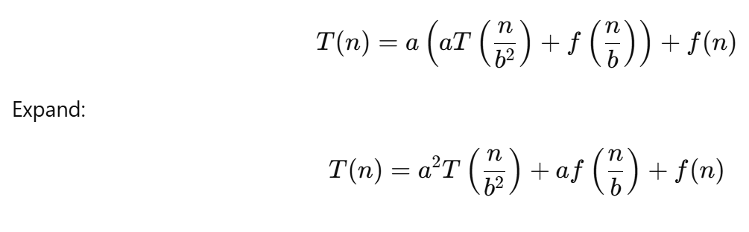
🔁 Step-by-Step Substitution Method for aT(n/b​)+f(n)
✅ Step 2: First Expansion
Substitute once:

Slide 11
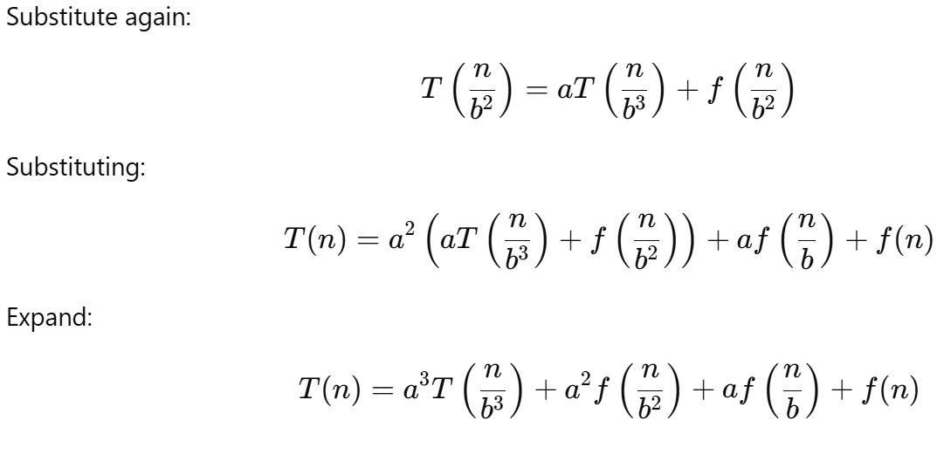
🔁 Step-by-Step Substitution Method for aT(n/b​)+f(n)
✅ Step 3: Second Expansion

Slide 12
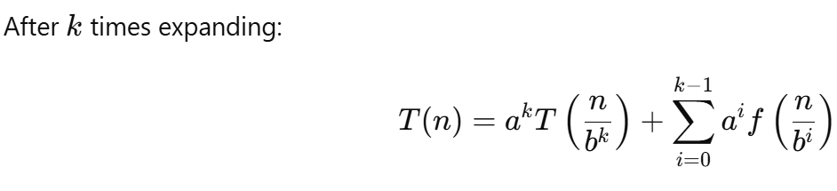
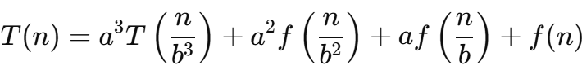
🔁 Step-by-Step Substitution Method for aT(n/b​)+f(n)
✅ Step 4: General Pattern After k Expansions
Last one was

Slide 13
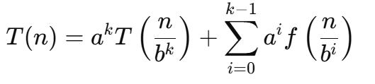
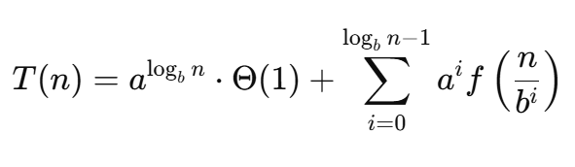
🔁 Step-by-Step Substitution Method for aT(n/b​)+f(n)
✅ Step 5: Find When Recursion Stops (Base Case)
Recursion stops when:
n/b^{k}=1 ⇒ n=b^{k} ⇒ k=log_{b}n
Step 6: Substitute Base Case
At base case T(1), assume T(1)=Θ(1)
Thus:
⇒

Slide 14

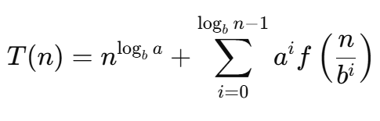
🔁 Step-by-Step Substitution Method for aT(n/b​)+f(n)
Using properties of logarithms:
Thus:
Previous one was

Slide 15
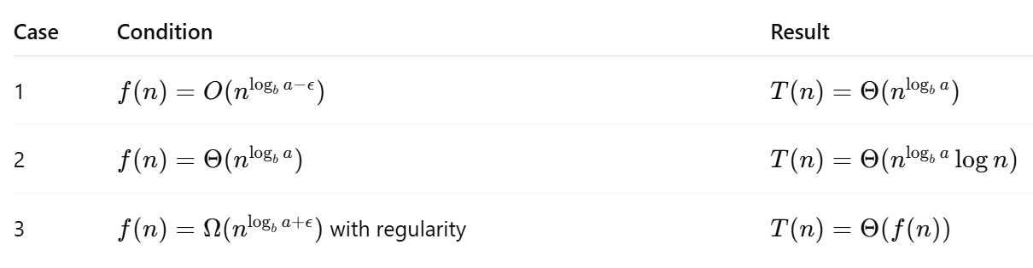
🔁 Step-by-Step Substitution Method for aT(n/b​)+f(n)
Step 7: Final Simplification
Depending on f(n), 3 cases arise (this leads to Master Theorem):

Slide 16
Master Theorem
The Master Theorem gives a shortcut to find the time complexity of divide-and-conquer recurrences without drawing recursion trees or substituting repeatedly.
It applies to: T(n)=a.T(n/b)+f(n)
Where:
a≥1 : number of subproblems
b>1 : size of each subproblem is reduced to n/b
f(n) : cost of dividing and combining

Slide 17
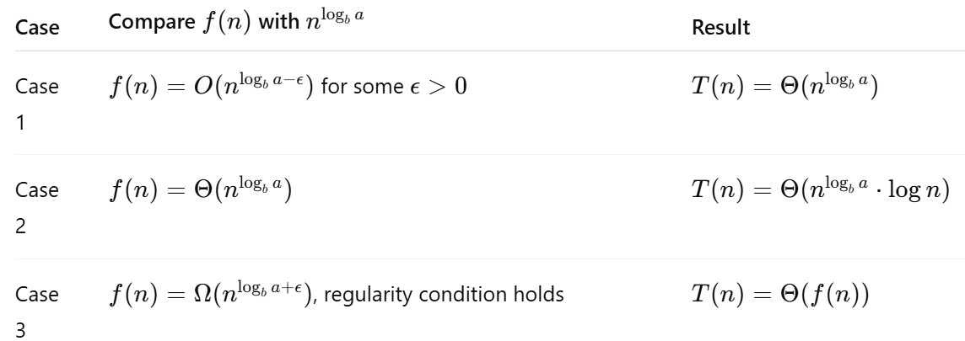
Master Theorem cases (Simple Table)

Slide 18
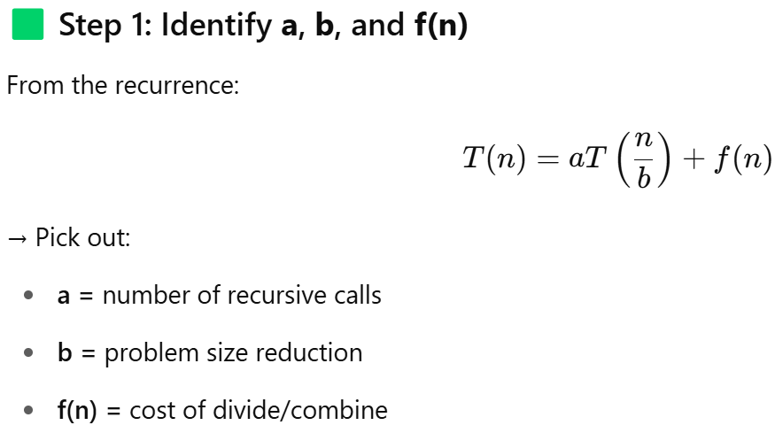
Step-by-Step Guide to Apply Master Theorem

Slide 19
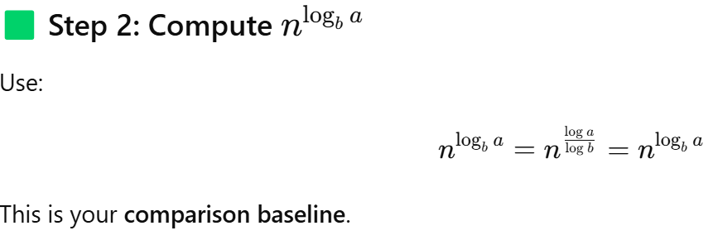
Step-by-Step Guide to Apply Master Theorem

Slide 20

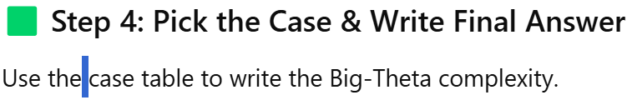
Step-by-Step Guide to Apply Master Theorem

Slide 21

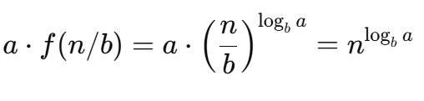

Let’s understand the shape of the recursion:
Basic
b=2, a=8
Level 0:
You start with size n
Level 1:
You divide the problem into a parts, each of size n/b
Work done = a⋅f(n/b)
Level 2:
Each of those a subproblems again splits into a sub-subproblems…
You now have a² subproblems of size n/b², and again:

Slide 22




Key Realization:
✅ Every level of the recursion does roughly the same amount of work:
How many levels?
The recursion goes until n becomes 1: n→ n/b → n/b2 →⋯→ 1 ⇒Number of levels=log_{b}​n
Total Work = Work per Level × Number of Levels
So total work:

Slide 23
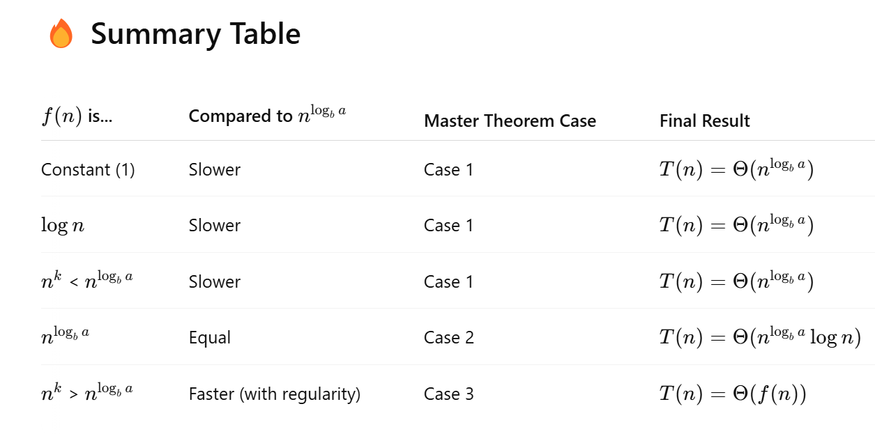

Slide 24
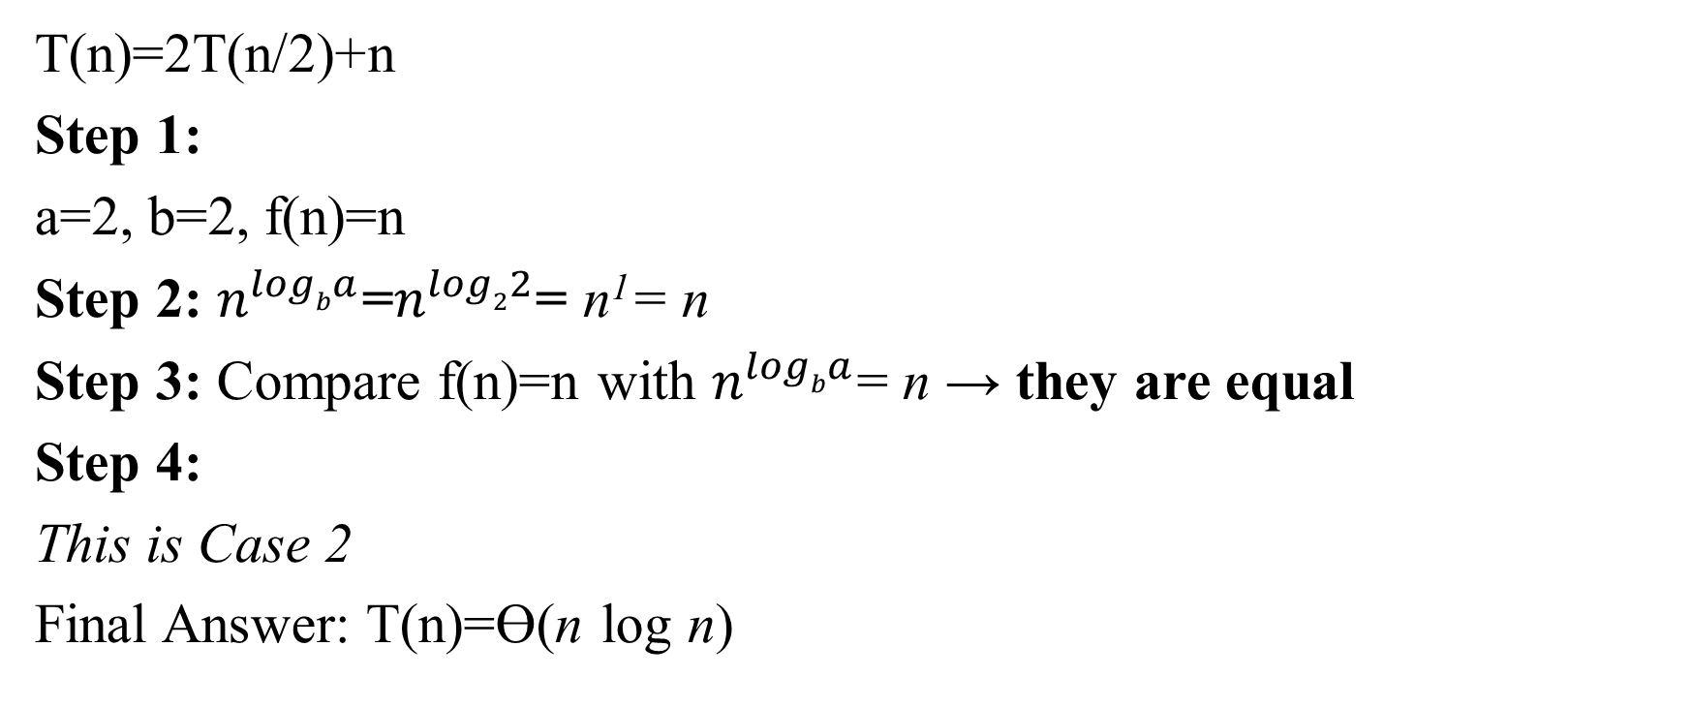
Example 1: Merge Sort
T(n)=2T(n/2)+n
Step 1:
a=2, b=2, f(n)=n
Step 2: $n^{logba}$=$n^{log22}$= n¹= n
Step 3: Compare f(n)=n with $n^{logba}$= n → they are equal
Step 4:
This is Case 2
Final Answer: T(n)=Ɵ(n log n)

Slide 25

Binary Search
T(n)=T(n/2)+n
Step 1: a=1,b=2, f(n)=n
Step 2:
Step 3: f(n)=1 Θ(n⁰)
Step 4:
Case 2 again
✅ Final Answer:
T(n)=Θ(log n)

Slide 26


Strassen’s Matrix Multiplication
T(n)=7T(n/2)+n²
Step 1: a=7, b=2, f(n)=n²
Step 2:
Step 3:
f(n)=n²=O(n^{2.81})
Step 4:

Slide 27


